Slide 1
GROUP TASK 5
Sentiment Analysis of Russo-Ukrainian War using Social Media Discussion Corpus applying NLP techniques
Submitted by: GROUP 5
Members:
Sumaiya Sinha (20101141)
Shouri Saha (20101349)
Eftakhairul Islam (20101390)
Taslima Islam (20101603)
Submitted to:
Annajiat Alim Rasel (AAR)
RA:
Sabbir & Mehnaz

Slide 2
ABSTRACT
Natural Language Processing uses sentiment analysis to help computers interpret and analyse text. Researchers utilise this method to better understand human emotions and language to gain insights. It is becoming increasingly significant as social media spreads massive data that can benefit many sectors. Twitter and Reddit are two of the largest social media platforms where users share vital data. This study aims to better understand conflict feelings using this data. NLP and sentiment analysis can help us interpret disputes in these instances. This study uses Twitter and Reddit data for sentiment analysis of the Russian-Ukrainian war. We demonstrate that ROBERTA, BOW, and Decision tree NLP models can interpret public positive, negative, and neutral sentiment. This study provides a complete grasp of this war's rhetoric.

Slide 3
INTRODUCTION
We aimed to conduct sentiment analysis on social media platforms regarding the Russo-Ukrainian War discussion. Inspiration was drawn from a recent scholarly article concerning sentiment analysis in Covide-19. Following this, we intend to conduct additional comparisons among the positive, negative, and impartial portions on the Twitter dataset using RoBERTa and Bow model. This analysis will assist us in gauging public opinion on the subject and gathering data on the suffering of the populace, thereby contributing to the effort to bring attention to the matter.

Slide 4
RELATED WORKS
“Sentiment Analysis On Twitter Posts About The Russia and Ukraine War With Long Short-Term Memory" by Allwin M. Simarmata, Anthony, Tiffany, Matthew Evan Phanie. 2537 Twitter posts were collected and a LSTM Model was used. Positive: 54.7%, Neutral: 35%, Negative: 10.2%.
“Sentiment of the Tweets on Russo-Ukrainian War: the Social Network Analysis” by A. Poleksić and S. Martinčić-Ipšć. Tweets containing keywords "Ukraine" and "Russia" during May, October, November, and December 2022 were collected. Used VADER for sentiment analysis. Negative (57%), neutral (32%), positive (11%).
“Public Sentiment and Emotion Analyses of Twitter Data on the 2022 Russian Invasion of Ukraine” by M. B. Garcia and A. Cunanan-Yabut. 27,894 tweets containing #UkraineRussia hashtag posted within the first day of the invasion were collected. Used VADER for sentiment analysis. 70% negative, 26% neutral, 4% positive.
“Characterizing the 2022- Russo-Ukrainian Conflict Through the Lenses of Aspect-Based Sentiment Analysis: Dataset, Methodology, and Key Findings” by M. Caprolu, A. Sadighian and R. Di Pietro. 5.5+ million Twitter posts related to the conflict, generated by 1.8+ million unique users were collected. Used lexicon-based approach for sentiment analysis.
“Semantic Analysis of Russo-Ukrainian War Tweet Networks” by Benjamin Džubur, Žiga Trojer and Urša Zrimšek. Over 1.5 million tweets containing hashtags related to the Russo-Ukrainian War were collected and a LSTM Model was used. Positive 54.7%, neutral 35% and negativity: 10.2%.

Slide 5
METHODOLOGY
Data collection
Analysis of data
Data cleaning
Pre-processing of data
Do classification analysis
Running different models
Define positive and negative Twitter hashtags and show wordcloud.
Result visualization

Slide 6
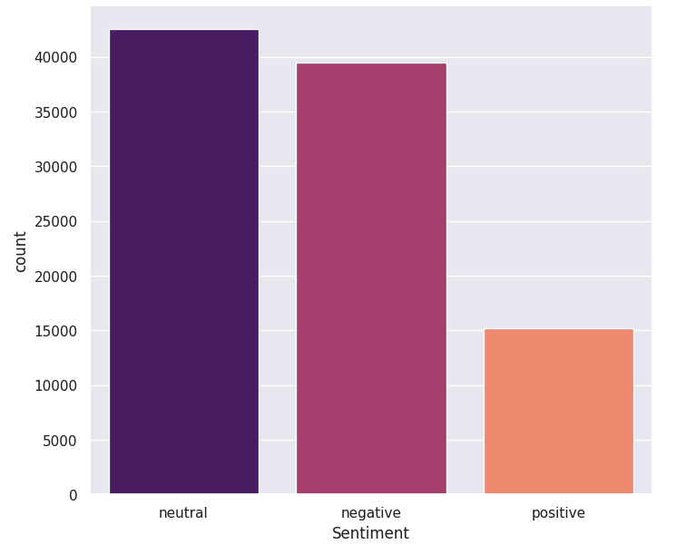
Result
Classification Analysis
Sentiment Analysis (by using RoBERTa):
Negative sentiment: Close to maximum number of the tweets had a negative sentiment. Around 39000 data. This shows that most people were against the war and wanted it to stop.
Neutral sentiment: Maximum number of tweets around 42000 data. This shows that people were not in support of either Russia or Ukraine and were neutral against the war.
Positive sentiment: 14000 data. This shows some people were entertained by the war.

Slide 7
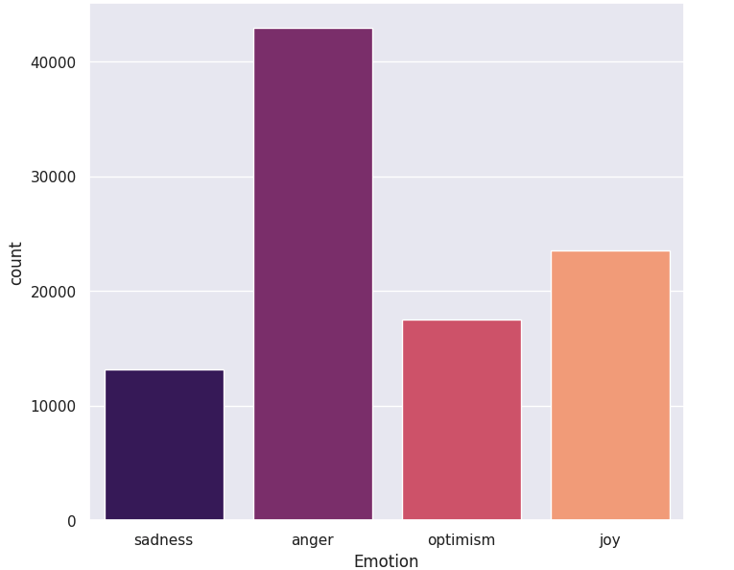
Result
Classification Analysis
2. Emotion Analysis (by using RoBERTa):
Anger: Maximum posts (44000) showed anger in them. This shows that most of the people were angry because of this war.
Optimism: 18000 tweets expressed optimism, which could mean people were hoping that the war would be soon over.
Sadness: 13000 posts showed sadness.
Joy: 22000 posts were showing joy due to this war.

Slide 8
Limitations
Our research has some limitations that can improved in the future works.
Our dataset contains multiple languages but in our research we dealt with English tweets only as specified models always doesn't work best on all languages.
Our dataset may seem biased depending of the collection location.
We used BOW and ROBERTA for analyzing the conflict sentiment. But more efficient custom model could be made building on this.

Slide 9
Future Work
Expand the analysis beyond English to include other prominent languages discussed online, such as Russian, Ukrainian, and other European languages
Analyze the evolution of sentiment over time, identifying trends and shifts in public opinion as the conflict unfolds.
Identify the key topics discussed in social media conversations about the war, including specific events, actors, and narratives.
Compare and contrast the sentiment expressed towards the war across different social media platforms and geographical regions.
Develop explainable AI models for sentiment analysis to understand the factors that contribute to the sentiment expressed online.

Slide 10
CONCLUSION
This study used Twitter and Reddit to analyse 2022 Russia-Ukraine conflict attitudes. We learned about public opinion and conflict emotions using sentiment analysis methods like RoBERTa and BoW. We can see that English tweets were dominated by fear and wrath, whereas Russian tweets were negative. Support for Ukraine, appeals for peace, and concerns about the conflict's implications were global themes. Texts in their native languages indicated sentiment and lexical differences.

Slide 11
REFERENCE
Guerra, A., & Karakuş, O. (2023). Sentiment analysis for measuring hope and fear from Reddit posts during the 2022 Russo-Ukrainian conflict. Frontiers in Artificial Intelligence, 6. https://doi.org/10.3389/frai.2023.1163577
Xu, A., Tiffany, T., Phanie, M. E., & Simarmata, A. M. (2023). Sentiment analysis on Twitter posts about the Russia and Ukraine war with long Short-Term memory. Sinkron : Jurnal Dan Penelitian Teknik Informatika, 8(2), 789–797. https://doi.org/10.33395/sinkron.v8i2.12235
A. Poleksić and S. Martinčić-Ipšć, "Sentiment of the Tweets on Russo-Ukrainian War: the Social Network Analysis," 2023 46th MIPRO ICT and Electronics Convention (MIPRO), Opatija, Croatia, 2023, pp. 1089-1095, doi: 10.23919/MIPRO57284.2023.10159770.
M. B. Garcia and A. Cunanan-Yabut, "Public Sentiment and Emotion Analyses of Twitter Data on the 2022 Russian Invasion of Ukraine," 2022 9th International Conference on Information Technology, Computer, and Electrical Engineering (ICITACEE), Semarang, Indonesia, 2022, pp. 242-247, doi: 10.1109/ICITACEE55701.2022.9924136.
M. Caprolu, A. Sadighian and R. Di Pietro, "Characterizing the 2022- Russo-Ukrainian Conflict Through the Lenses of Aspect-Based Sentiment Analysis: Dataset, Methodology, and Key Findings," 2023 32nd International Conference on Computer Communications and Networks (ICCCN), Honolulu, HI, USA, 2023, pp. 1-10, doi: 10.1109/ICCCN58024.2023.10230192.

Slide 12
THANK YOU

